Slide 1
Diabetes Predictive Model
Gautam Sood & Jacob Managan

Slide 2
INTRODUCTION
Diabetes is a disease that affects over 537 million people globally. That means roughly 1 in 10 people have some form or may develop some form of diabetes in their life. Due to unhealthy eating habits and lack of exercise this number is said to rise to 637 million by 2030.
As machine learning has grown over the past decade many researchers and computer engineers have ventured into the space of training ML models to help doctors with this very problem. Early detection is crucial in preventing or delaying further complications in a patient due to the illness.

Slide 3
Methodology
Data Collection
Data Cleaning
Exploratory Data Analysis
Feature Engineering
Train/test split
Model implementation
Model evaluation
Model deployment

Slide 4

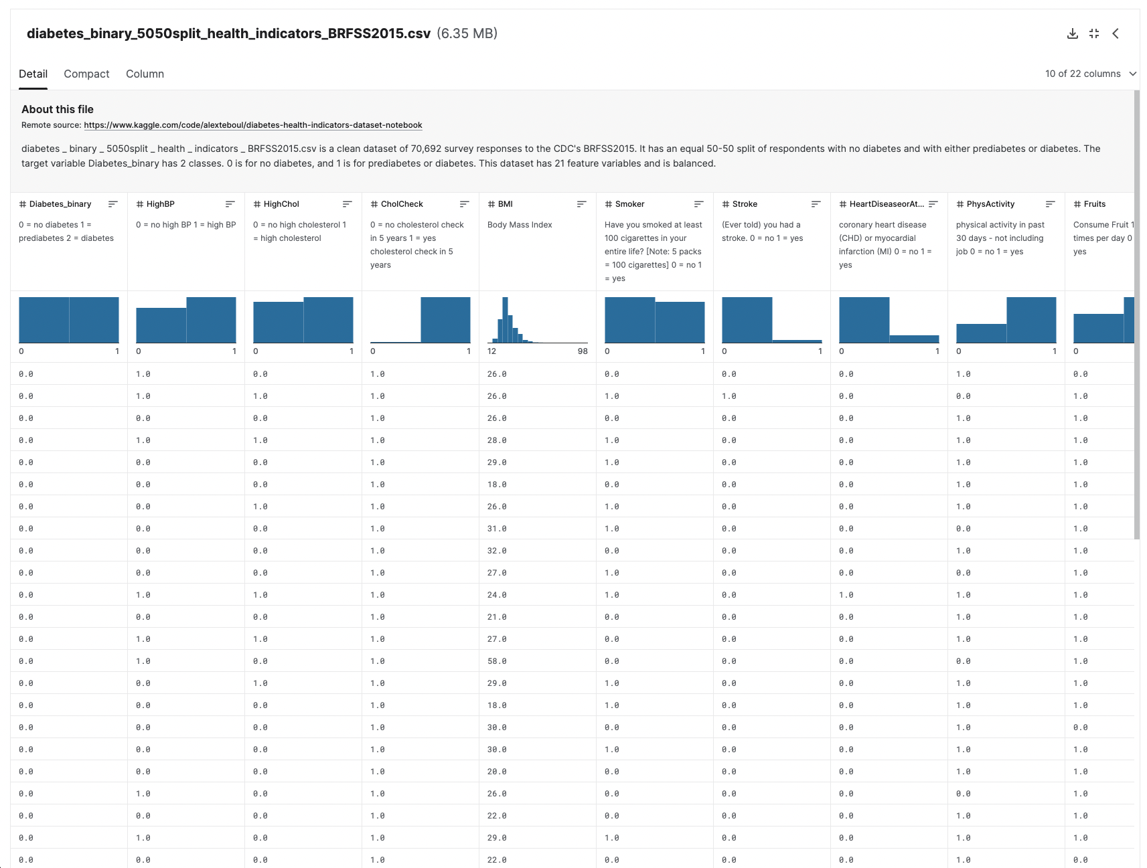
Data
To train, test, and evaluate our ML model we used a dataset found on Kaggle. Kaggle is an amazing platform that has a machine learning and data science specific content.
The data set which we used from Kaggle includes medical information along with lifestyle information which was collected through various surveys and laboratory tests. It has 253,680 survey responses and 21 features collected directly from the CDC (center for disease control). Along with the demographic information and clinical measurements.

Slide 5
Libraries Used
01
02
Ski-kit Learn
NumPy
03
04
05
Pandas
Matplotlib
Seaborn
Popular ML library with multiple models
Useful library for doing math on arrays/matrices
Open-source library for data analysis
Data visualization library
Built upon matplotlib also used for visualization

Slide 6
Feature Selection
Chi-squared test
Feature selection is an important machine learning process that’s used to create a subset of relevant features or variables taken from a larger dataset. Its primary goal is to identify the most important features in any given dataset and only use those when training the predictive model.
Chi-squared is a statistical method used primarily in feature selection to determine the strength of association between two categorical variables. It’s main goal just like any other feature selection method is to determine which features are most relevant when predicting the target variable and training the model.

Slide 7
Models we used
In random forests, each decision tree is trained on a subset of the input data and a random selection of input features. The RF combines the result of the decision trees to make a final more well-informed prediction.
Logistic Regression
This algorithm assumes that all features in the data set are independent which makes the runtime more efficient and less computationally expensive.
Decision Trees
Naïve Bayes
Decision trees work by recursively splitting the training data based on the statistical significance of the features, with each node having the goal of creating the most informative split.
Random Forest
Logistic regression works by fitting a logistic curve to the data that maps the input variables to the predicted probability of the event occurring.

Slide 8
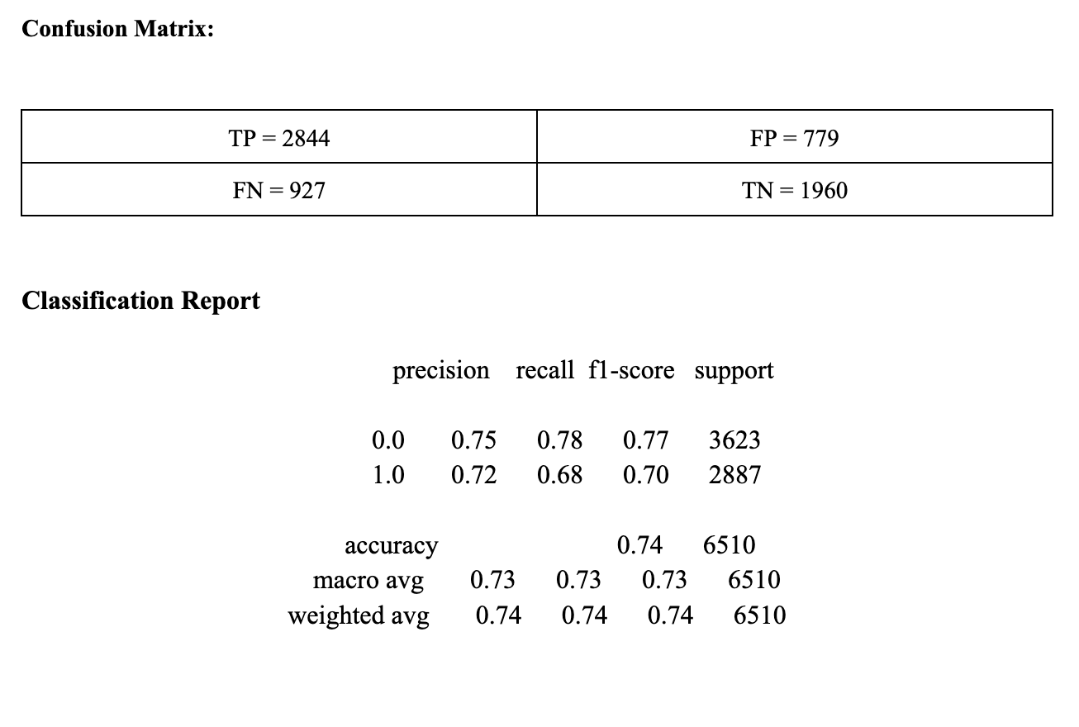
Logistic Regression
Accuracy: 0.7379

Slide 9
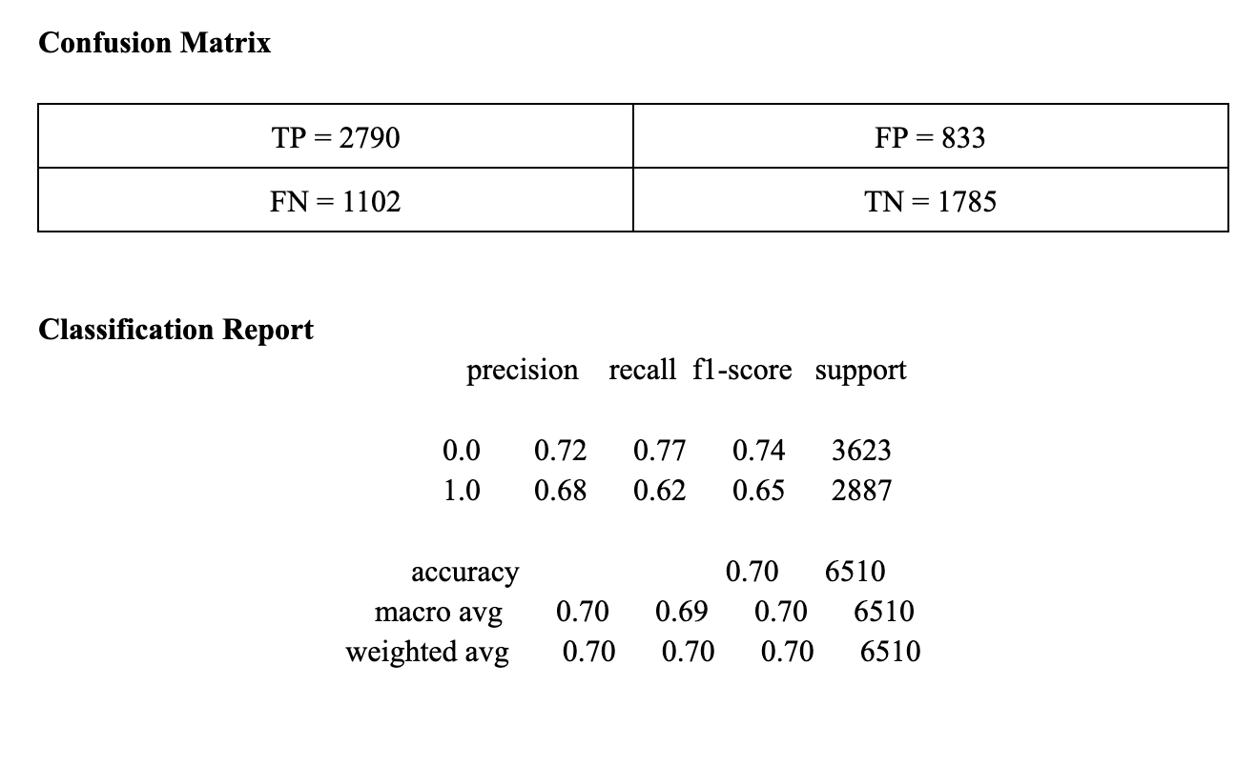
Gaussian Naive Bayes
Accuracy: 0.7028

Slide 10
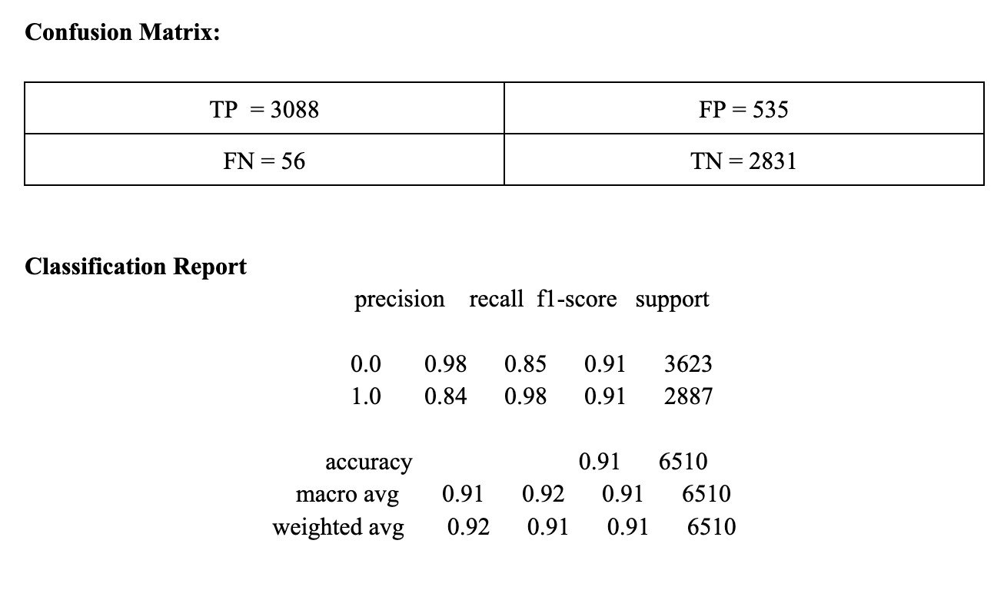
Decision Tree
Accuracy 0.9135

Slide 11
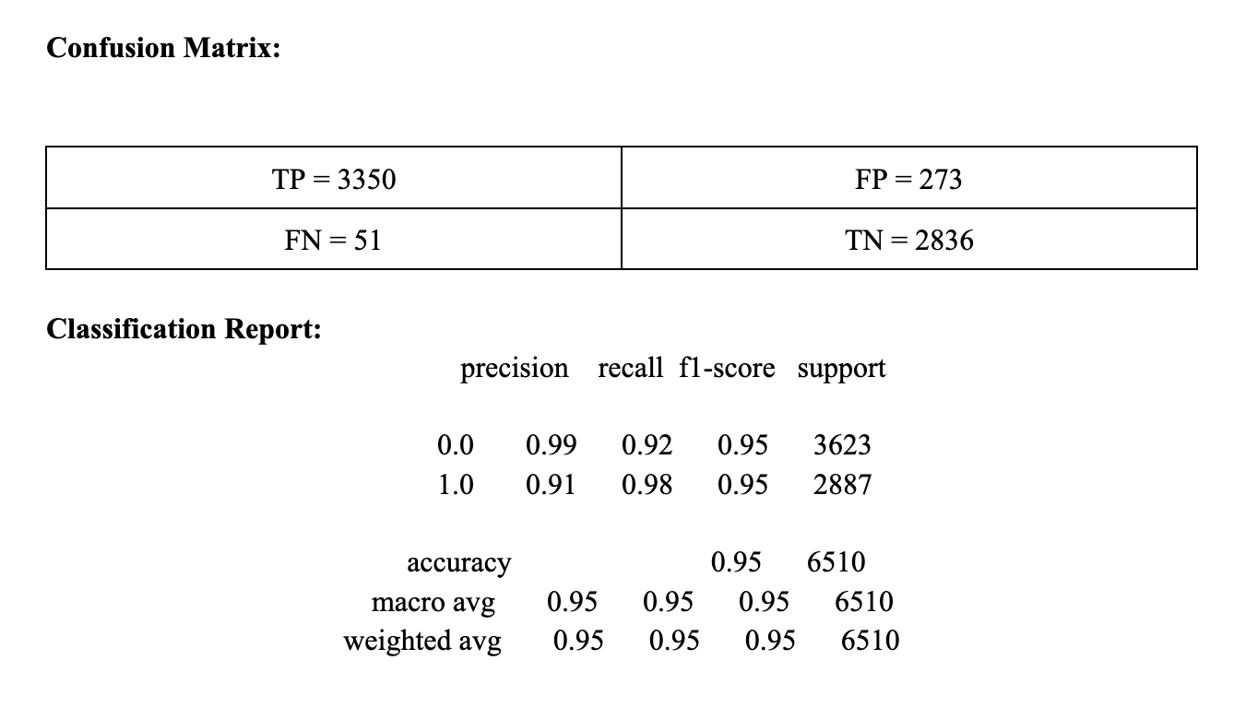
Random Forest
Accuracy: 0.9531

Slide 12
Team Contribution
Gautam Sood
Jacob Managan
Code, Slides, Report, Video
Code, Slides, Report, Video

Slide 13
Overall, our study and results demonstrate the power that machine learning algorithms have in predicting diabetes and provide information for the use of clinical features as predictors.

